Slide 1
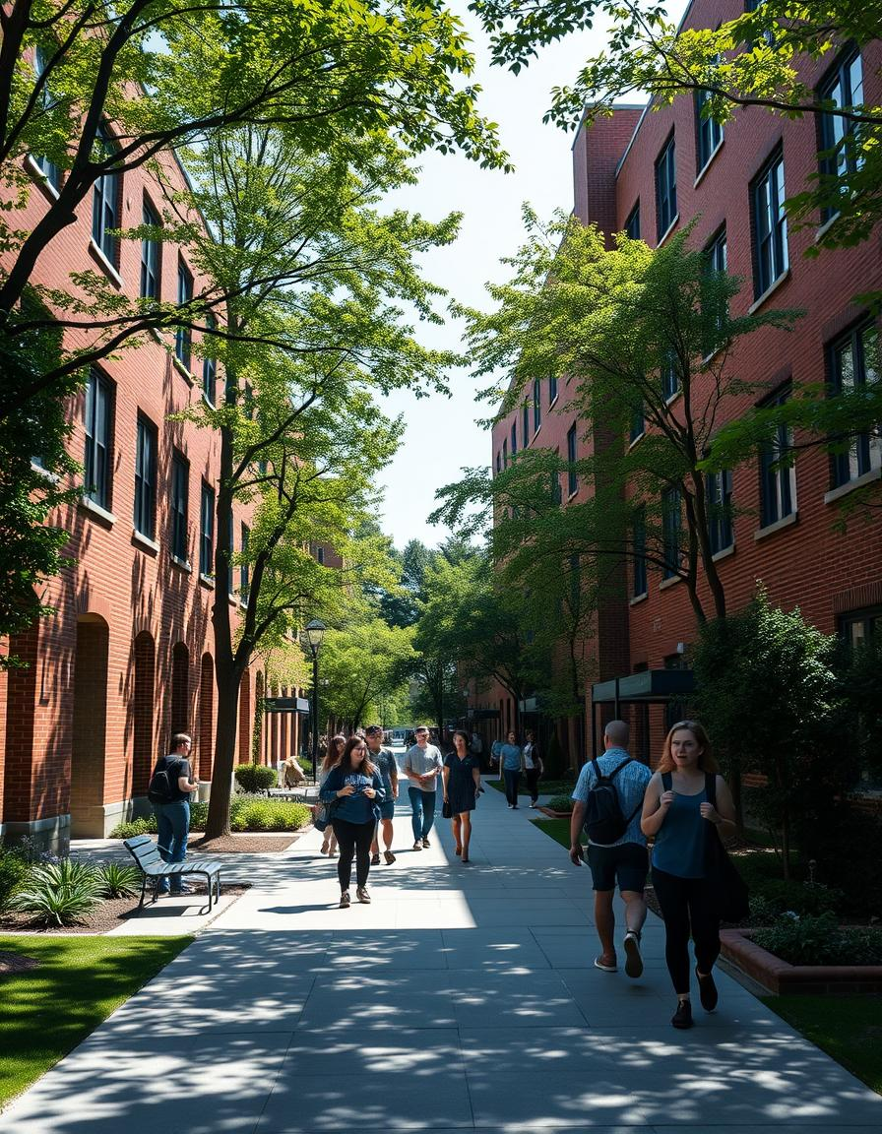
Optimizing Student Database Systems for Enhanced Academic Management
Group Members:
Nitan sharma
Akashdeep
Arpita sharma
Venkateswarlu

Slide 2
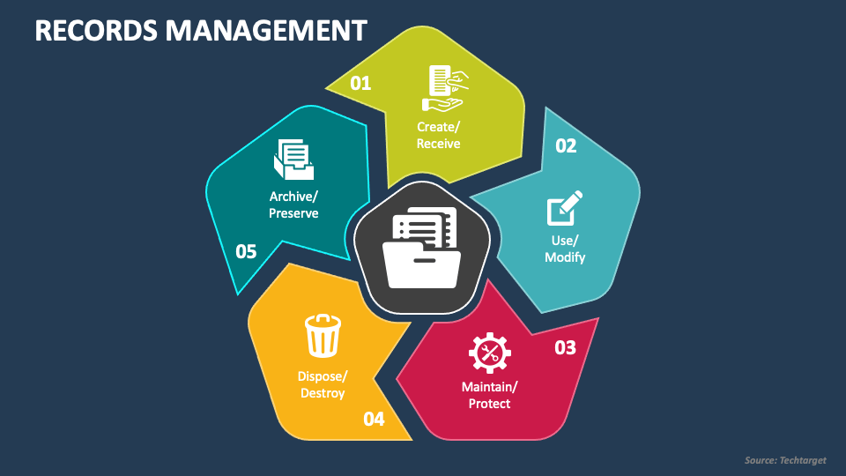
Purpose: The primary goal of this project is to create an efficient and user-friendly system for managing student records. This system will allow administrators or users to perform CRUD (Create, Read, Update, Delete) operations on student data. It aims to improve data organization, facilitate record management, and provide a more accessible interface for interacting with student information.

Slide 3

Technologies Used:
Python: The core programming language for building the system.
Python's simplicity and versatility make it an ideal choice for building the back-end logic and interacting with the database.
2.SQLite: A lightweight, serverless database to store student records locally.
SQLite is used because it's easy to set up, does not require an external database server, and fits well for this small-scale application.
3. Tkinter: Python's standard GUI library for building the graphical interface.
Tkinter provides tools to create buttons, text fields, labels, and other UI elements for a smooth and interactive experience
4. PrettyTable: A library for displaying data in a formatted and readable table.
PrettyTable makes it easier to visualize and print student records neatly in a table structure.
5. Colorama: A library for adding color to the text output in the terminal.
Colorama is used to color-code outputs, making it easier to read and highlight important information, such as errors or confirmations.
6. Rich: A library for rendering advanced text-based user interfaces with rich formatting.
Rich is used for adding stylish and formatted output in the console, such as colorful tables, progress bars, and other features that improve the user experience.

Slide 4

1.streamline student data management:
Use a centralized database
Automate processes
Maintain consistent data format
Implement data validation
Integrate with other systems
2.provide a user-friendly interface for easy access:
Design an intuitive layout
Include clear navigation
Use meaningful labels and icons
Prioritize important information
Implement user-friendly controls
3.ensure data integrity and security:
Implement encryption for sensitive data
Set up user authentication mechanisms
Regularly back up data
Apply access controls
Conduct security audits

Slide 5

Features of the Student Records Management System
Add Student Records
View Student Records
To add student records to the database in your project, you can create a function or interface that allows users to input and store student information. This function should include fields such as student name, ID, courses, grades, etc., and should interact with the database to save the entered data securely
To view student records in your project, you can create a feature that retrieves and displays student information from the database. This feature should allow users to search, filter, and view student records based on criteria such as student ID, name, course, grades, etc. The interface should present the data in a clear and organized format for easy viewing and analysis.
Update Student Records
Delete Student Records
To update student records in your project, you can implement a functionality that allows users to modify existing student information in the database. This feature should provide options to edit fields such as student name, ID, courses, grades, etc. Users should be able to search for specific student records and make necessary updates while ensuring data integrity and security
To delete student records in your project, you can create a functionality that enables users to remove specific student information from the database. This feature should include options to search for and select the student records to be deleted, with appropriate confirmation prompts to prevent accidental deletion. It's essential to implement this feature securely to maintain data integrity and prevent unauthorized deletions

Slide 6
User-Friendly GUI for Interaction
Display Student Data in a Structured Format
Intuitive Design: Design the interface with simplicity and clarity in mind. Use familiar layouts, colors, and controls to enhance usability.
Logical Navigation: Ensure easy navigation between different functionalities and screens to provide a seamless user experience.
Clear Feedback: Provide informative feedback messages to guide users on their interactions with the system, such as successful data updates or error notifications.
Responsive Design: Make the interface responsive to different screen sizes and resolutions for a consistent experience across devices.
Accessibility: Consider accessibility features such as keyboard shortcuts and screen reader compatibility to cater to users with diverse needs.
To display student data in a structured format in your project, you can consider using a tabular layout to present the information in an organized manner. This format allows for easy viewing and comparison of student records. Additionally, you can categorize the data into columns such as student ID, name, courses, grades, etc., to provide a clear and structured presentation of the student information.

Slide 7
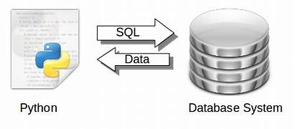
Table Structure:
id (INTEGER, PRIMARY KEY)
name (TEXT, NOT NULL)
age (INTEGER, NOT NULL)
grade (TEXT, NOT NULL)
You can use this table structure to store student data in the SQLite database efficiently. The "id" column serves as the primary key to uniquely identify each student record, while the "name", "age", and "grade" columns store corresponding information for each student

Slide 8
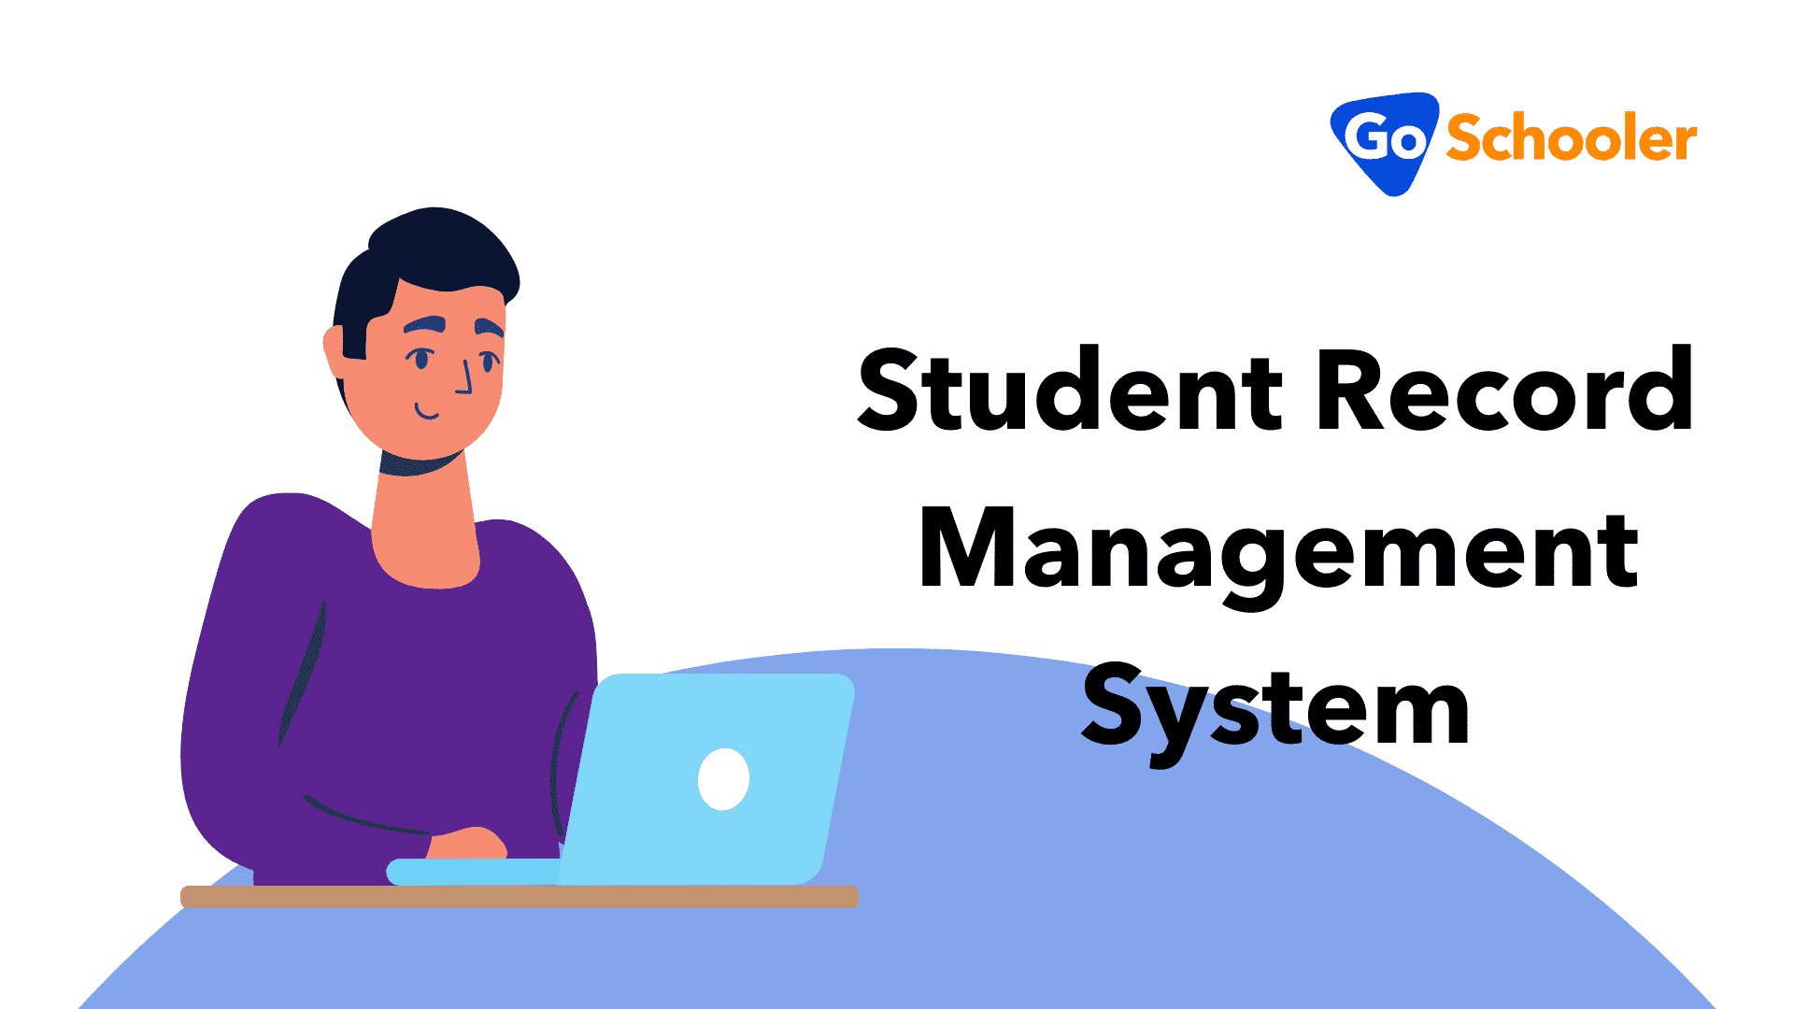
Overview of the Application Structure:
The application consists of a user-friendly GUI for interacting with the student database system.
It includes functionalities for adding, viewing, updating, and deleting student records.
The GUI interacts with the SQLite database to perform CRUD operations on student data.
Interaction between GUI and Database:
The GUI sends user input and requests to the backend application.
The backend application processes these requests and interacts with the SQLite database using SQL queries.
Data is retrieved from the database and displayed in the GUI for user interaction.
Flow of Data within the Application:
User interacts with the GUI by adding, viewing, updating, or deleting student records.
GUI sends requests to the backend application.
The backend application processes the requests, performs database operations, and retrieves data.
Data flows back to the GUI for display and interaction with the user.

Slide 9
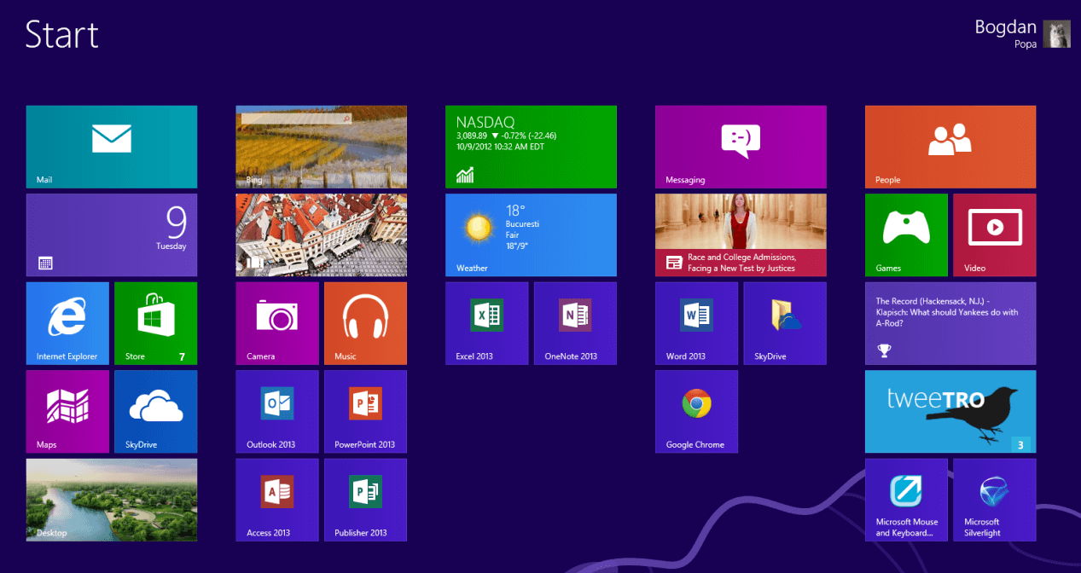
User Interface Components:
Input Fields:
ID (for entering student ID)
Name (for entering student name)
Buttons:
Add (to add a new student record)
View (to view student records)
Update (to update existing student records)
Delete (to delete student records)
Text Area:
Display area to show student records in a tabular format

Slide 10
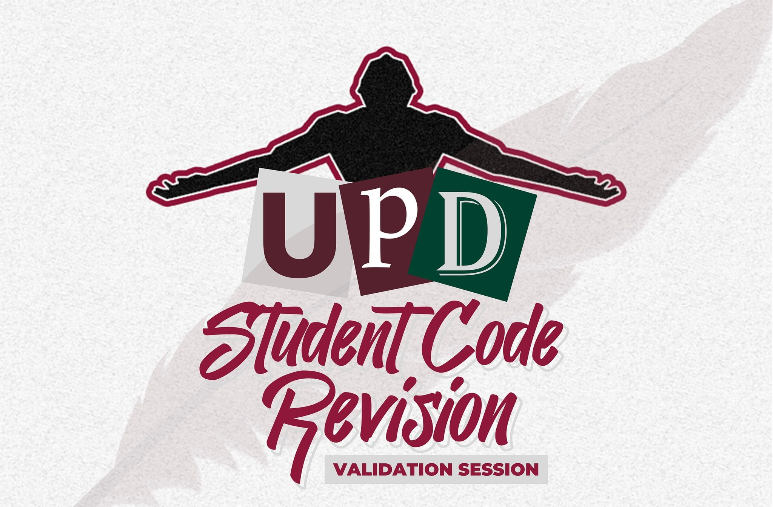
Adding a Student: Process and Validation
Process of Entering Student Details:
Provide input fields for ID, Name, Age,Grade.
User fills in the required information.
User clicks the "Add" button to submit the data.
The system processes the input and adds the student record to the database.
Validation Checks for Input Fields:
Ensure the ID is unique and not empty.
Validate that the Name field is not empty and within a specified character limit.
Check that the Age is a valid integer within a specified range.
Verify that the Grade is not empty and follows a specific format.
Confirmation Messages for Successful Addition:
Display a success message confirming the addition of the student.
Show the details of the added student for verification.
Provide an option to add another student or return to the main menu

Slide 11
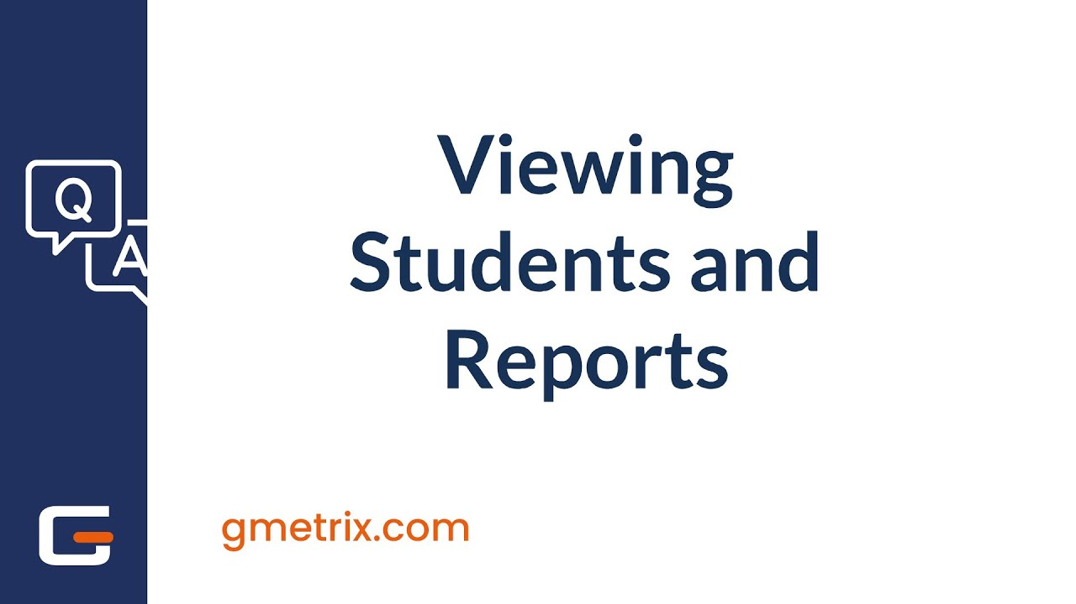
Viewing Students: Fetching and Displaying All Student Records
The View Students feature allows users to view all student records that have been added to the system. This is a read-only function where all existing student data is retrieved from the database and displayed in a structured format
1. Fetching Student Records from the Database
The first step in the process is to query the SQLite database to fetch all student records.
2. Formatting the Output Using PrettyTable
Once the student records are fetched from the database, we need to display them in a structured, human-readable format. The PrettyTable library is used to display the data in a table-like format. PrettyTable helps present the data with columns, borders, and clear alignments.
3. Displaying the Student Records in the GUI
The formatted table will be displayed inside a Text Area widget in the GUI. This allows users to view all student records at once. Each time the user clicks the View button, the application will query the database for the records, format them into a table using PrettyTable, and show the result in the Text Area widget.

Slide 12
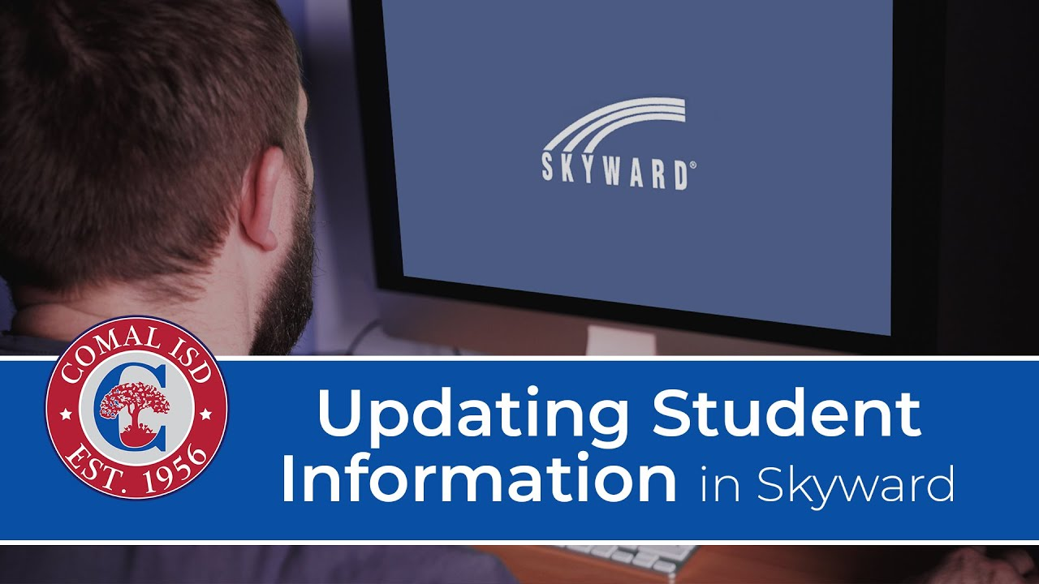
Updating a Student: Modifying Existing Student Information
The Update Student feature allows users to modify the details of an existing student record. This could involve changing the student's Name, Age, or Grade. The process includes selecting the student to be updated, entering the new details, validating the inputs, and saving the changes to the database.

Slide 13
Steps to Modify Existing Student Information:
Provide a search functionality to locate the student record to be updated.
Display the current student details in the input fields.
Allow users to modify the student information.
Upon clicking the "Update" button, apply the changes to the database.
Error Handling for Invalid Inputs:
Validate the input fields for correctness (e.g., ID format, name length).
Display error messages for invalid inputs and prevent the update process until corrections are made.
Confirmation Messages for Successful Updates:
Show a success message confirming the update of student details.
Display the updated information for verification.
Offer an option to update another student or return to the main menu.

Slide 14
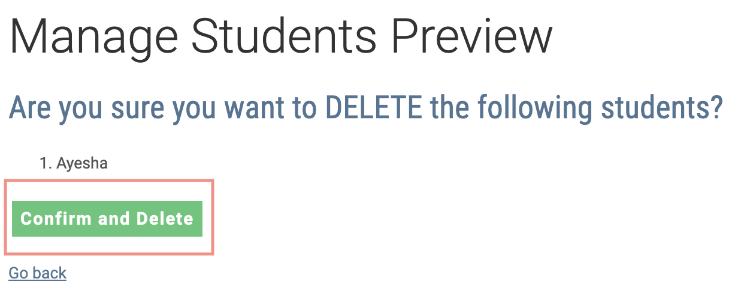
Deleting a Student: Process for Removing a Student Record
The Delete Student feature allows users to remove an existing student record from the database. This action is permanent, so it is crucial to implement proper confirmation prompts before deleting the student to prevent accidental deletions

Slide 15
Conclusion:
The Student Records Management System has been developed to address the need for efficient, secure, and user-friendly management of student information. Through the integration of Python, SQLite, Tkinter, and various libraries such as PrettyTable and Colorama, we have created a robust application that fulfills key objectives, ensuring the seamless management of student data.
MY Link

